Slide 1
ENTERPRISE INFORMATION SECURITY
SECURITY RISKS

Slide 2
Common Enterprise Information Risks
Phishing entails hackers luring management officers to wire money into their accounts.
CEO Spoofing
Malware occurs when hackers pose as CEOs and email co-workers soliciting money for company transactions.
Internal threats occur when laid-off employees reveal companies’ information to rival firms.
Internet of Things enables hackers to use remote access to access the information systems of enterprises.
Malwares are viruses that attack information systems to gain access to data such as passwords.

Slide 3
Process of Assessing Enterprise Exposure to Risk.
Evaluation of resources software and hardware to identify vulnerabilities.
Assessing the impacts of the threats and the magnitude of the losses to the company.
Analyzing the threats to determine the probability of attacking the enterprise information system (Rot, 2009).
Analyzing the effectiveness of the security systems installed within the information framework.
Evaluating the susceptibilities of a various utilities to malware.

Slide 4
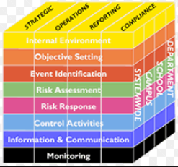
Cont.
Analyzing the frequency of occurrence of the threat.
Assessing the persistence of the risk within the information system.

Slide 5
Enterprise Risk Management Process
Risk identification carried out on various functional units.
Risk analysis to measure the magnitude of the destruction.
Risk-mitigating approaches
Risk monitoring.

Slide 6
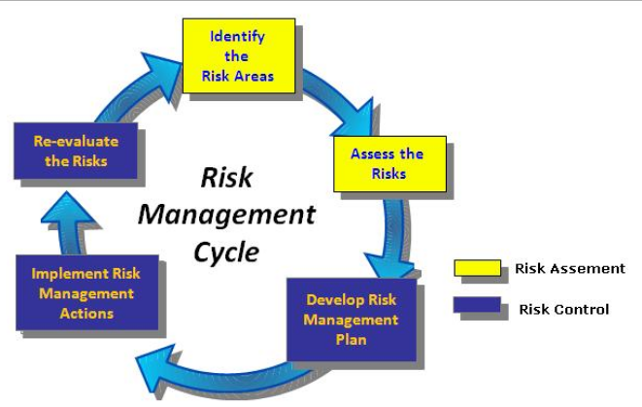
Cont.
ERM implementation to manage risks into quantifiable numbers.
Risk review to identify cost-effective mitigation measures (Hoppes et al, 2014).

Slide 7
Risk Mitigation Measures
Securing access points within the enterprise information system using encryption keys.
Installing anti-malware software to prevent malicious threats.
Educating the employees on the various risk-mitigation strategies and various cyber security risks.
Separation of functional environments to eliminate security gaps.
Adopting standardized risk management systems that aligns with those of other companies.

Slide 8
Cont.
Tracking potential threats to prevent possible occurrences.
Dealing with both high-level and low-level threats (Quon et al., 2012).
Transferring and contracting individuals to investigate various risk areas.
Buffering risks to reduce the severity of damage.
Identifying alternative strategies to give prevent penetration of potential threats,

Slide 9
Elmer: Governance framework in the Organization and System Acquisition Plan
Information technology governance
Ethical consideration in the governance framework.
Effects of IT governance on strategic planning.
Procurement procedures.
Developmental approaches.
Spiral methodology.
Implementation and realization of strategic plan.

Slide 10
Data Collection Plan
Working out a logic model
Resource allocation
Surveys
Interviews
Focus groups
Cost estimation
Customer Relationship Management.

Slide 11
Company and Management
The board members include:
Ann LeCroix, a partner at Blessed Chefs Inc.
Brian Liam, a partner at Jubilee Accounting LLP
Peter Toms, President of Light IT and Communications Ltd.
Services:
24- hour home delivery service
Bakery services by highly qualified staff
Preparing Customized Doughnuts for special occasions
Home baking for events
Mail collection services
Garbage collection

Slide 12
References
Hoppes, M., Rickert, S. H., Youngberg, B. J., McCarthy, B. A., Shope, D…. Driver, J. (2014). Enterprise risk management: A Framework for success. ASHRM. 1- 21.
Quon, T. K., Zeghal, D., & Maingot, M. (2012).
Enterprise management and firm performance.
Procedia Social and Behavioral Sciences. 62(1), 263-267.
Rot, A. (2009). Enterprise information technology security: Risk management perspective. Proceedings of the World Congress on Engineering and Computer Science. 2(1), 1-6.

